Slide 1
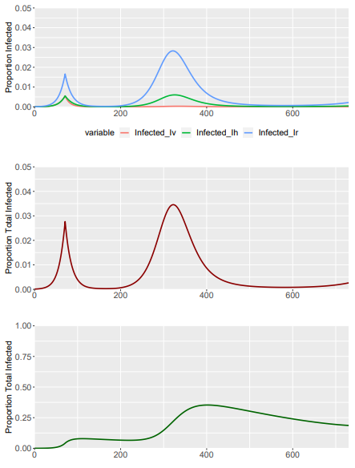
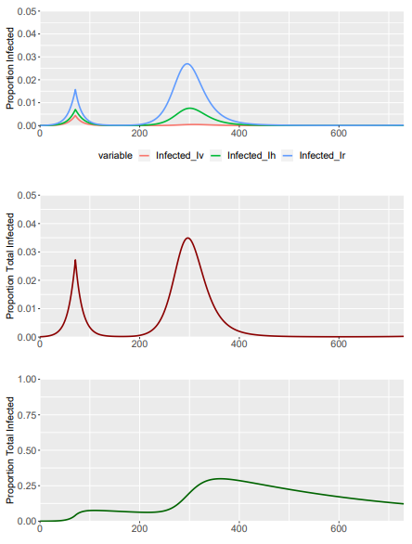
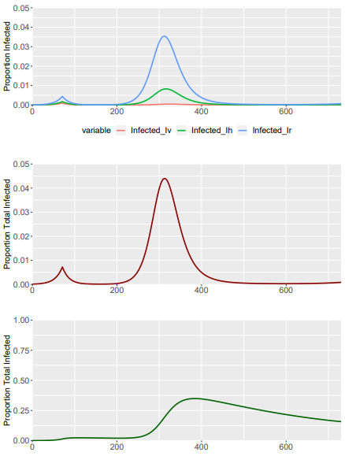
Baseline Model – SIGMA PARAMETER– DELTA = 0.33
Sigma = 1 (Delta = 1) - Baseline
Sigma = 1.3
Sigma = 1.08

